Slide 1
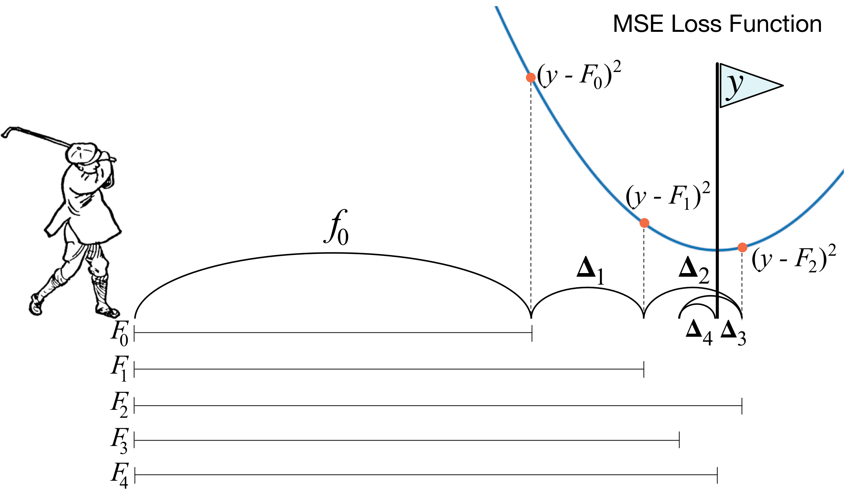
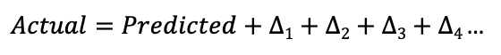
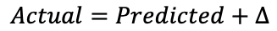
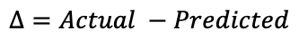
Gradient Boosting (1)
The core idea behind gradient boosting is to build a series of weak estimators which incrementally add a scaled down residual value to the Expectation to slowly move the prediction closer to the actual based on a learning rate.
$$Δ=Actual −Predicted$$
$$Actual=Predicted+Δ$$
Can build a model to predict the residual !!
If I do that, then we will surely overfit the model i.e, we will have a low bias but extremely high variance. But we can take small steps towards our goal instead, very similar to what Gradient Descent does.
“Empirical evidence shows that taking lots of small steps in the right direction results in better predictions i.e lower variance”
– Jerome Friedman (inventor of gradient boosting)
$Actual=Predicted+Δ1+Δ2$ $+ Δ3$ $+ Δ4$…

Slide 2
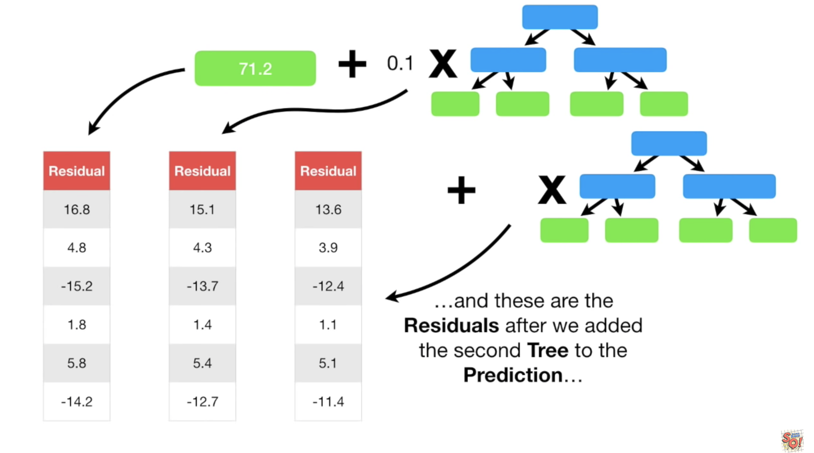
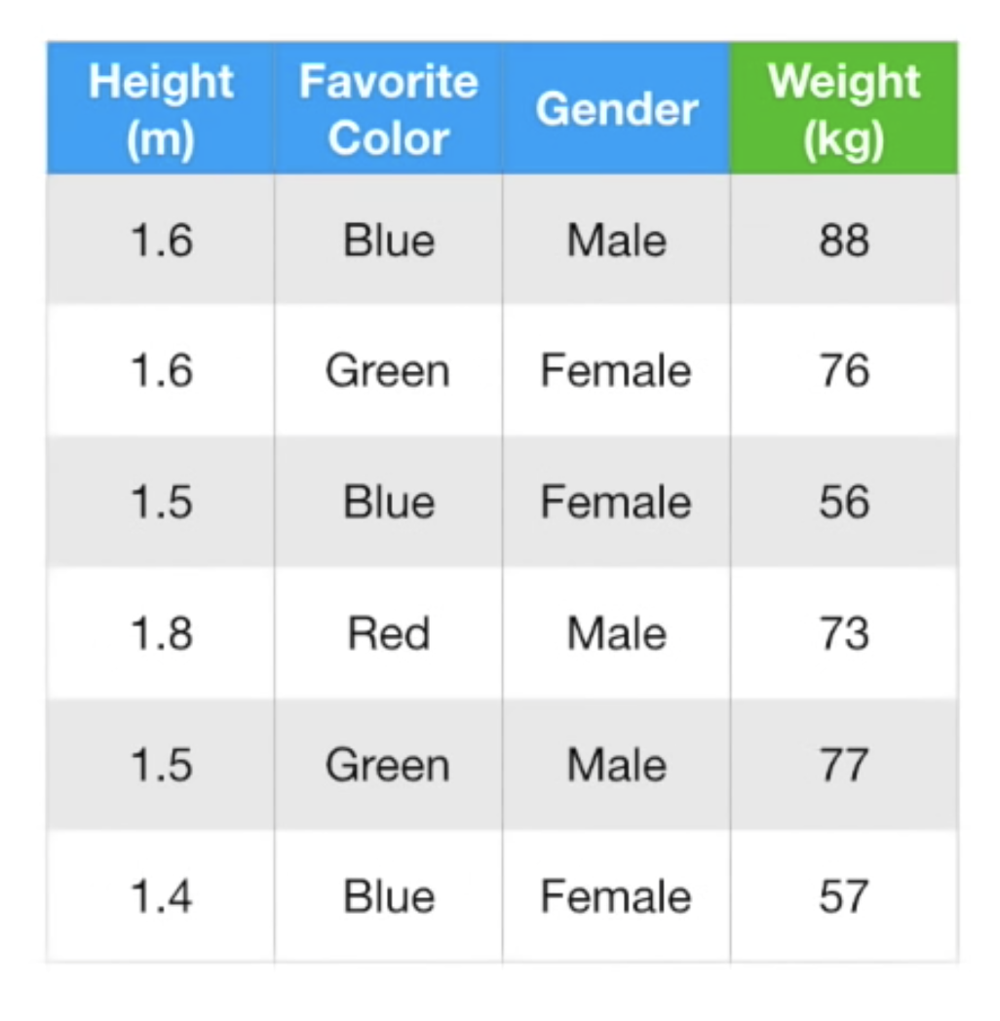

Gradient Boosting (2)
3. The residual (errors) calculated here is what our next estimator tried to predict. This prediction is multiplied by a learning rate
2. Gradient boost starts by making a single prediction equal to the E(y)
1. Consider a sample dataset for regression (predicting weight)
4. Regression trees of fixed height are trained as weak learners
5. Summing up the E(y) with these predicted scaled residuals for the n_estimators moves us closer to the actual
6. Notice how the residuals for each of the samples gradually reduces as more trees are trained on the previous residuals

Slide 3
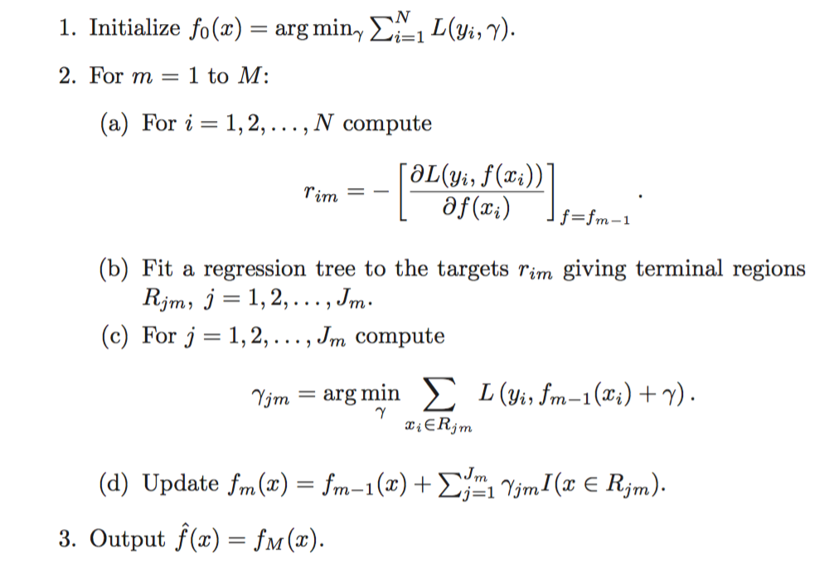
Gradient Boosting (3)

